Slide 1
In this segment
CORBA Addressing
Addressing Overview
Interoperable Object Reference (IOR) format
The original CORBA Naming Service
CORBA Interoperable Naming Services
Corbaloc
Corbaname

Slide 2

CORBA Addressing
Overview
Major address formats in CORBA
Interoperable Object Reference (IOR) format
Uniform Resource Identifier (URI) formats from CORBA Interoperable naming services
Corbaloc
Corbaname
Address is obtained using “string_to_object” function on client object, which takes address string and returns object reference
Reference is then narrowed to proxy object using Helper methods
Other address formats (optional) are:
file://filename (name of the file that contains address)
http://url (URL that contains address)
ftp://filename (location of file that contains address)

Slide 3
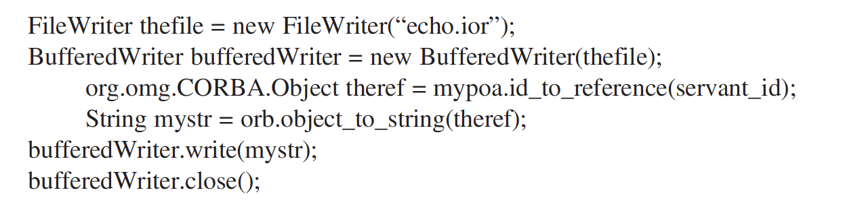
CORBA Addressing
Interoperable Object Reference (IOR)
Original addressing format started by CORBA (1991)
IOR is created on server and shared with client (via email/sftp) in string format
IOR contains:
IP address and port Number
Object reference (for skeleton)
Unique ID for the Interface
Version of Internet Inter-Orb Protocol (IIOP)
IOR provides “tagged profiles”, each of which would contain different sets of information to obtain address

Slide 4
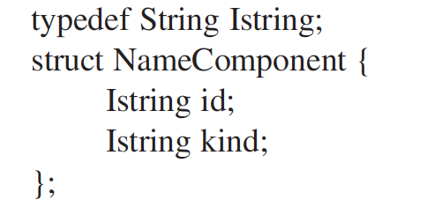
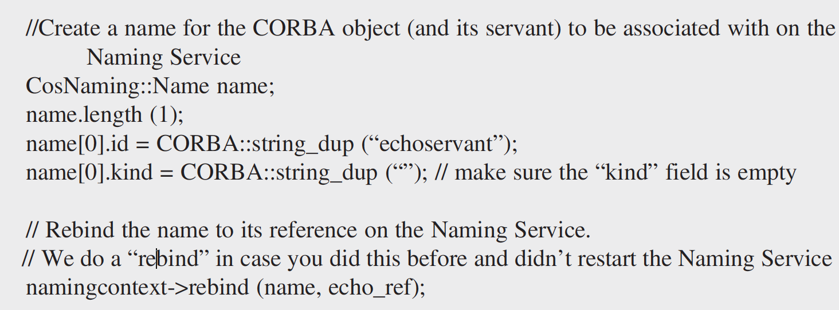
CORBA Addressing
The Original CORBA naming service
Maps domain names to object references (analogous to DNS)
Naming service runs separately, included by ORB vendors
Server “binds” name to CORBA object reference using CORBA naming interface
Naming works hierarchically like directory structure, but uses naming graph to represent the structure (due to CORBA’s naming limitation with ‘/’)
Naming service interface is represented as IDL (in ORB source code)
Each node is represented as a struct defined in IDL containing its parents and its own details

Slide 5
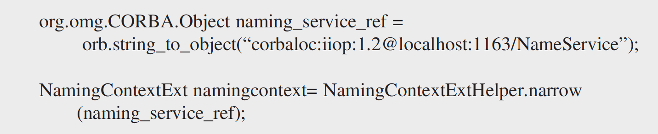
CORBA Addressing
CORBA Interoperable naming service
Introduced in CORBA 2.4 spec (2000)
Contains two addressing formats: corbaloc and corbaname
Corbaloc
corbaloc:iiop: < host IP address>:< port number>/object_key (default port 2809)
corbaloc:rir: < host IP address>:< port number>/object_key (resolves initial references)
corbaloc:iiop:1.2@[ipv6 address]:<port number>/object_key
Ex: corbaloc:iiop:localhost:4321/theObjectKey
Corbaname
corbaname: <corbaloc format including object key as before> #name string
Ex: corbaname::theServer.edu:1234#echo
Can be used to find Naming service with “rir”

